Slide 1

React Native

Slide 2

Introduction To React Native
Israel Zablianov
Frontend Developer, Wix B2B

Slide 3
What is React Native
Build cross platform application using JavaScript and React
Supports multiple targets, e.g. Android, IOS, WEB, macOS, tvOS, Windows etc.
Released by Facebook In Mar 27, 2015 as an open source

Slide 4
Why React Native
Learn once write anywhere
Code reuse and cost saving
React and JS ecosystem
Written in JS, rendered with native code
Multiple Targets

Slide 5










Who’s using React Native
Facebook
Instagram
Shopify
Discord
Tesla
Skype
Pinterest
Wix
Salesforce
Walmart

Slide 6
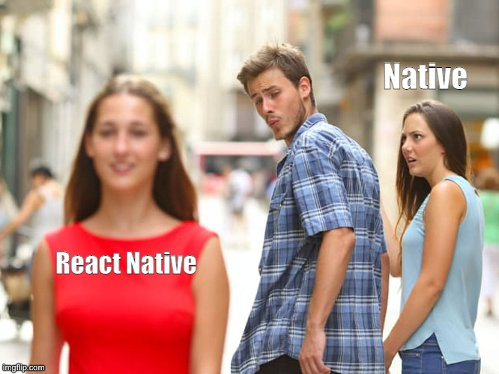

Slide 7
How does React Native work
Each platform has a native entry point
All JS code is bundled to a single file
The native entry point will invoke the bundled JS file in a separated thread
Communicate with the native threads using React Native bridge
JS Thread
Bridge
JSON
JSON
Main (UI) thread

Slide 8
UI Element
Bridge
JS Thread
Render
<Button
title=“Click”/>
Click
Clicked

Slide 9
React Native API
Components
Services
React Native Community
View
Text
TextInput
Button
Image
ScrollView
FlatList
NativeModules
Dimensions
Animated
PixelRatio
Vibration
Linking
Alert
AsyncStorage
Navigation
Camera
Maps
Etc.

Slide 10
React Native vs Web
Core Components / Tags
Styling
Web API’s
JS Engine
Deployment

Slide 11
React Native vs Web
Core Components / Tags
React Native | Web
View | div
Text | span
TextInput | input
Image | img

Slide 12
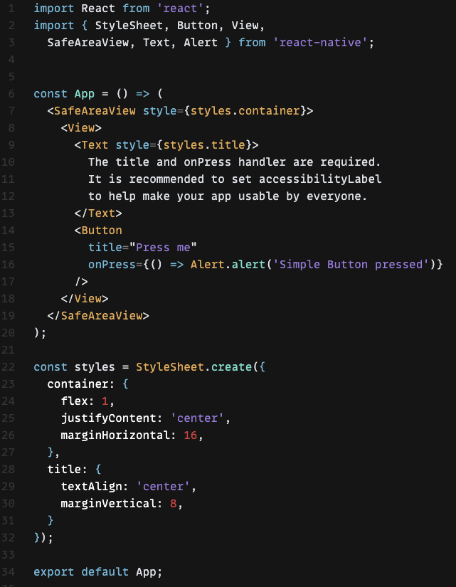
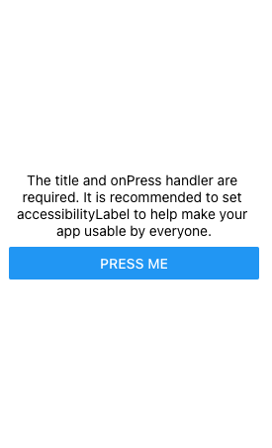
How it looks

Slide 13
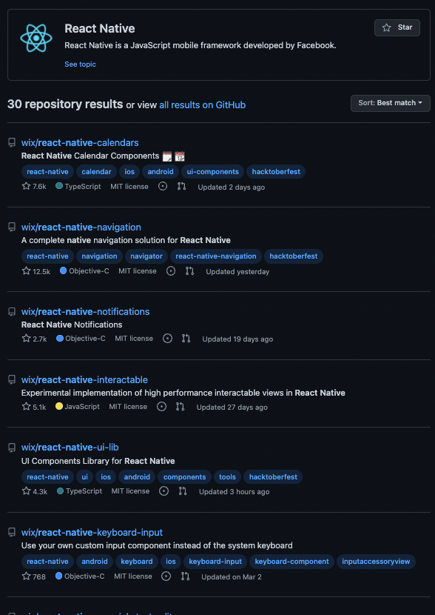
React Native at Wix
RNUI - UI Toolset & Components Library for React Native
react-native-calendars
react-native-navigation
Detox - automation framework for native and React Native apps

